Slide 1
Cardiovascular Disease Risk
CLAUDIO MONCADA,SASHANTH EMBAKULA, SYED OMAR FAROOQ ALI

Slide 2
Background of the Problem
Cardiovascular diseases (CVDs) are the number 1 cause of death globally, taking an estimated 17.9 million lives each year, which accounts for 31% of all deaths worldwide.
ONE PERSON DIES ABOUT EVERY 37 SECONDS FROM CVD IN THE US. IT IS ESTIMATED BY 2030, OVER 1 MILLION PEOPLE IN THE US COULD DIE EACH YEAR FROM CVD.

Slide 3
Motivation
Cardiovascular Diseases are a major problem in many populations and with this study we want to help those that might be at risk. This is an unfortunate disease that millions suffer, and our plan is to find a way to improve the odd of finding those who could be at risk of a CVD.

Slide 4
Solution Methodology and Evaluation Metrics.
In evaluating the High-risk patients, we must identify if the patient is likely to succumb to the heart disease based on the data. The output column RISK would be used as a Y or a dependent variable. This is the prediction if the patient was tested positive for CVD or not. The variables would be used to understand how factors like Age, sex, diabetes, creatine and platelets levels etc. affect the decision of heart disease risk.

Slide 5
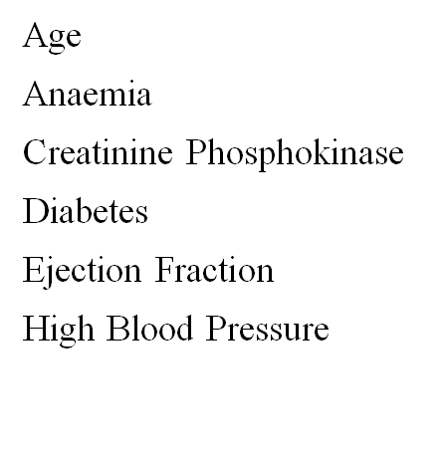
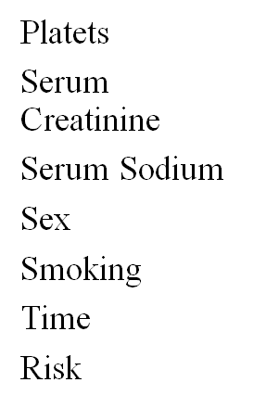

Description of the Database

Slide 6
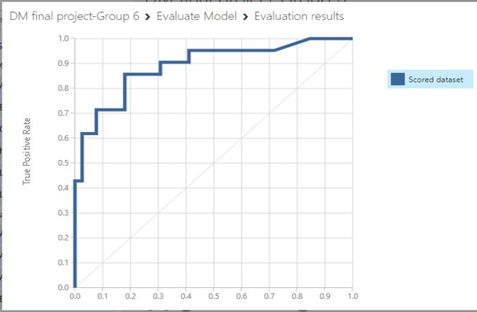
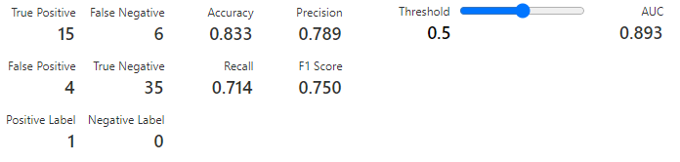
Two Class-Boosted Decision Tree

Slide 7
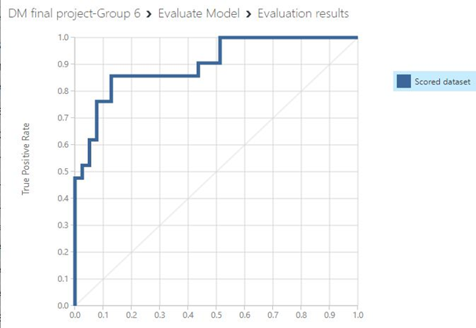
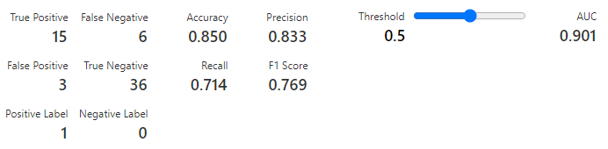
Two-Class Neural Network

Slide 8
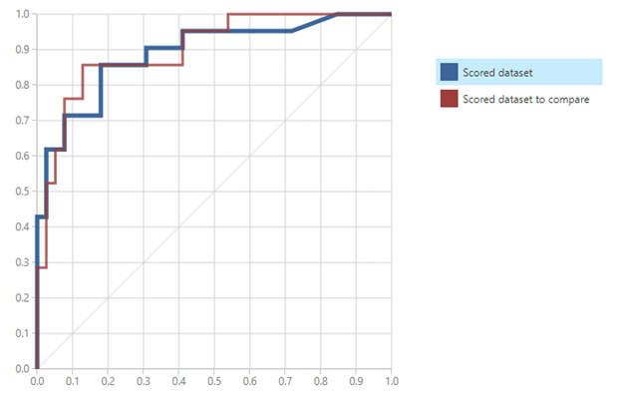
Comparison of Both Models

Slide 9
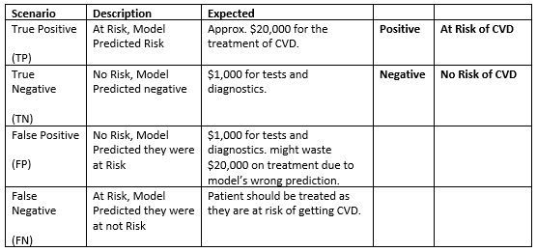
Monetary Value

Slide 10
Conclusions
The comparison between both algorithms with default parameters and a threshold of 0.5 shows the following results: It shows that the Two-Class Neural Network is comparatively better to predict if a patient is at risk of a heart disease. There’s a change in the No. of false positives.

